Slide 1
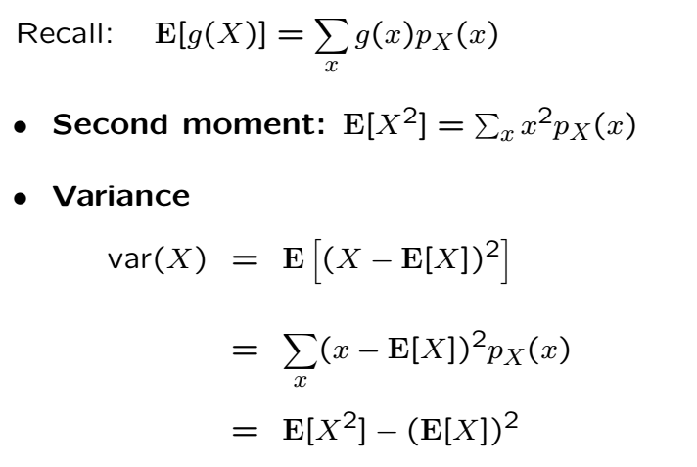
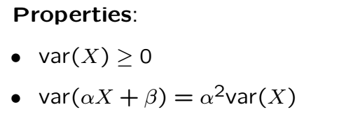
Variance
Measure of “spread” of the PMF

Slide 3





Variance Examples
Consider the effect of parameters on variance
Random Variable | Variance
Bernoulli
Geometric
Binomial
Pascal
Poisson
Discrete Uniform
Proofs require summation tricks (see textbook)

Slide 4
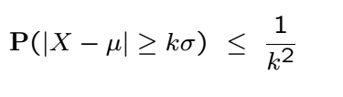
Chebyshev’s Inequality
An upper-bound on “tail probability”
Applies to discrete and continuous distributions
The prob. of being farther than k stds away from the mean
“Most of the probability is a few stds away from the mean”

Slide 5
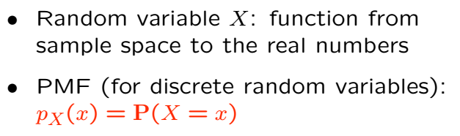
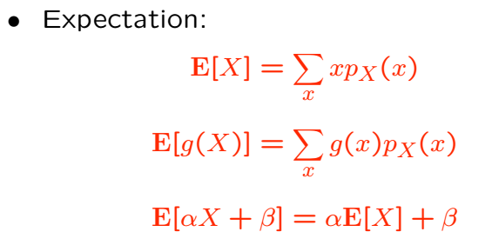
Review of Mean and Variance

Slide 6

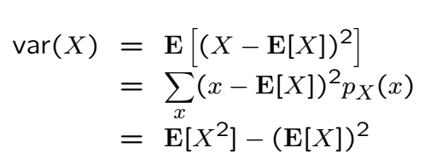

Review Cont’

Slide 7
Acknowledgements and Citations
Parts of these slides are adapted from the following resources:
Power Point Lecture Slides for the Textbook http://bcs.wiley.com/hebcs/Books?action=index&bcsId=8676&itemId=1118324560
John Tsitsiklis. 6.041 Probabilistic Systems Analysis and Applied Probability, Fall 2010. (Massachusetts Institute of Technology: MIT OpenCourseWare),http://ocw.mit.edu (Accessed 13 Apr, 2015). License: Creative Commons BY-NC-SA

